Slide 1
OP Solutions TestFramework
Insights and Demo
Team Automation
Date: May 30, 2018

Slide 2
Agenda
Insights
Why Automation?
Automation Framework Defined
1i TestFramework Components | PageFactory | Design Patterns | Coding Principles
Parallel Testing | 1i Goals | How Tests Go Parallel?
Shift Left in 1i SDLC via CT & CD | VSTS Dashboard
Summary | So, what have we achieved from all this?
Demonstration
Run a single Test
Run Multiple Tests Sequentially i.e. one by one
Run Multiple Tests In Parallel i.e. all at once (as per threads defined)

Slide 3

Why Automation?
In a world of nightly or weekend regression runs, the volume of testing has increased substantially. And with this increased volume of testing comes the need for test automation. DevOps can simply not succeed if it still requires a large number of test cases to be run manually.
Test automation: the secret to DevOps success

Slide 4
Automation Framework Defined
Application
(Browsers, etc.)
A good test automation framework can be defined as a high-level layer abstracting low-level details of interactions with the actual UI technology.
Proper abstraction is critical for usability and long-term effectiveness of any test automation suite.
Custom Code
(Step Definitions, etc.)
Runner Framework
(JUnit, TestNG, etc.)
Drivers
(WebDriver, etc.)
Notes:
Application: This is the actual UI technology being tested, such as a web browser, native iOS/ Android app, or WPF desktop application.
Driver: The driver is the lowest-level component. It knows how to interact with the application’s specific UI. For example, Selenium WebDriver has different drivers which know how to manipulate Chrome, Firefox, and Microsoft Edge.
Framework: Frameworks like Robot or Cucumber enable teams to write code which focuses on the business problem being tested, versus the specific UI technology. Teams write expressive tests that don’t focus on UI implementation details. This also enables, in some cases, the same test to be reused across different web browsers, mobile applications, etc. Custom Code: This is code specific to the teams’ needs and may include abstractions for interacting with page or view-level objects, communicating to web services, checking the database, etc.

Slide 5
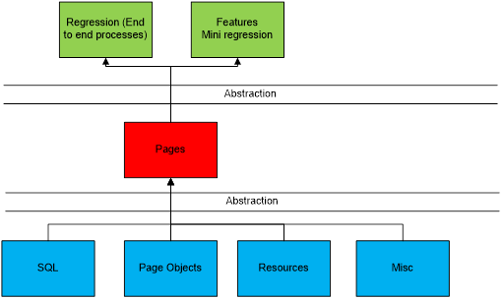
OP TestFramework Components
OP SELENIUM MISSION STATEMENT
Keep it Simple
Application
(Browsers)
Custom Code
(DSL)
Runner Framework
(TestNG, Maven)
Drivers
(Selenium WebDriver)
Regression: (End to End processes designed by the product owner). No coded business logic.
Feature Regression: (Specific regression tests for work done within the scrum). No coded business logic.
Pages: This is the business logic layer.
Objects: This contains the properties of the object for identification.

Slide 6
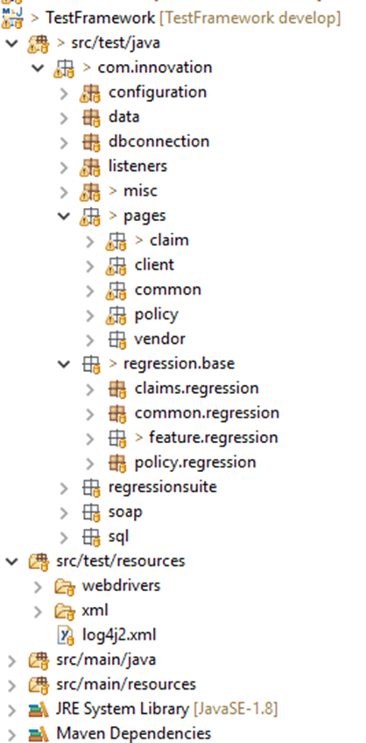
OP TestFramework Components (contd.)
Application
(Browsers)
1i TestFramework is built on / supported on:
Applications: Chrome, Headless, Firefox, IE, Edge
Driver: Selenium WebDriver
Runner Framework: TestNG
Build Tool: Maven
Team’s Custom Test Code: 1i DSL using PageFactory of POM
Custom Code
(DSL)
Runner Framework
(TestNG, Maven)
Drivers
(Selenium WebDriver)

Slide 7
Page Object Model – PageFactory
The Page Objects pattern describes any web page in terms of a hierarchical Domain Specific Language (DSL). The application specific DSL helps to hide the page implementation; the test is no longer allowed to directly interact with a given page, but instead uses a framework of classes and methods to accomplish the same goal. This pattern abstracts the implementation details, such as element IDs, into a framework specifically designed for the application being tested.
The DRY principle – Don’t Repeat Yourself
Take the common code that is regularly reused and put it into a centralized location, from where it can be repeatedly called. In the world of Selenium, these definitions are called Page Objects.
Separation of Concerns
Page objects are always separate to ensure that we have a clear separation of concerns. The commonly used page objects are placed into a function (method) and are being called wherever needed.

Slide 8
Page Object Model – PageFactory (cont.)
// Add Quote object/ element identified in Actions Panel Object class
@CacheLookup
@FindBy(how = How.LINK_TEXT, using = "Add quote")
public WebElement lnkAddQuote;
// Add Quote action defined in Actions Panel Page class
public void clickAddQuote ()
{
WebDriverWait wait = new WebDriverWait(driver, GlobalWaitTime.getIntWaitTime());
wait.until(ExpectedConditions.elementToBeClickable(OR_ActionsPanel.lnkAddQuote));
OR_ActionsPanel.lnkAddQuote.click();
}
// Add Quote method is being called in the main Test Script – serving as living documentation
seleniumWaiter.waitForMe (GlobalWaitTime.getIntWaitTime ());
TransactionTimer.start (stopwatch);
actionspanel.clickAddQuote ();
TransactionTimer.stop (stopwatch, "Policy Start Details", driver, strEnvironmentName);

Slide 9
Parallel Testing
Running your tests in parallel means different things to different people. There are two approaches to
achieve parallelism.
Cross Browser Approach
In this approach, we can run all of our tests against multiple browsers at the same time.
Same Browser Approach
In this approach, we can run all our tests against multiple instances of the same browser.

Slide 10
OP Parallel Testing Goals
We needed a versatile approach which would do all that includes not limited to:
It must allow us to run all our tests in parallel
It must allow us to run each test independently without tweaking anything
It must allow us to run our tests sequentially with just a single tweak
It must allow us to run our tests with and without Selenium Grid
It must support all browsers for our cross-browser testing needs
It must support re-run for tests that might fail due to network or data corruption issues
It must support ZAP scan for our security testing needs
It must work seamlessly with our backend / API layer integration
This has been achieved through harnessing the power of Maven with TestNG.

Slide 11
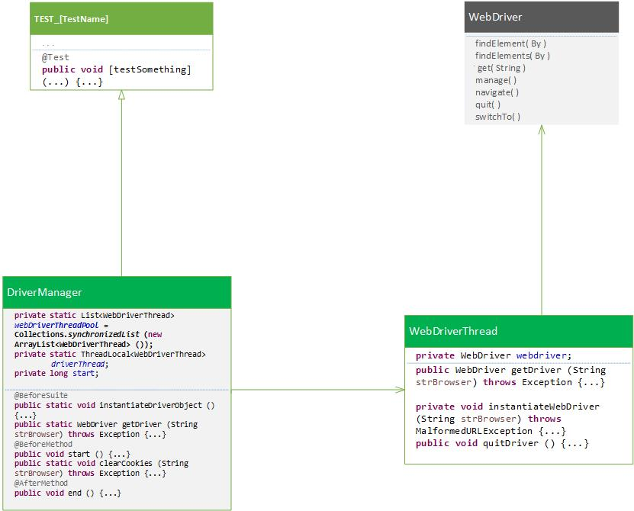
Design Patterns | How Do Tests Go Parallel in OP TestFramework?

Slide 12
Design Patterns | Coding Principles
Keep it simple
All controls should be parametrized either locally or from the regression layer
The code is written in JAVA currently JAVA 8
Code is built on Page Object Model using Page Factory – for reusability and separation of concern purposes
Data mining is used to parametrize scripts, also setup data is inserted via SQL and XML files wherever required
Each test is capable of running as a single test as well as running in parallel along other tests
Each test is safely locked in its own thread to avoid any kind of cross-contamination between tests
The scripts are designed such that they can be run over multiple machines and regions. (Build, Dev Local Machines, Sales environment)
Our scripts support running over Firefox Chrome, IE, & Edge, as well as headless for all supported browsers

Slide 13
Shift Left in 1i SDLC via CT & CD
Continuous Deployment
Req (V1)
Design
Dev
Test
- Test Req Review
- Collaboration with Dev, Design, PO.
-High level test Planning
-Static Analysis
-Automating Regression tests
-Test Coverage and Test Planning
-Test Data creation
-Design Review Sessions
-Automating Regression tests
-Functional & Regression test scripting
-Functional Tests usage in Unit testing
-Local Testing
-Automated System Health Check
-Automated Regression Tests
-Automated System Health Check
-Functional Testing
-Task Reporting, Tracking and Test case Re-Execution
-Performance Testing
-Automated Regression Tests
Shift-Left Testing Activities
Continuous Testing
Notes:
Shift Left Goal - focus on quality, work on problem prevention instead of detection, and begin testing earlier in SDLC. [1i has been doing this from the start of automation project]
How to Shift Left – requires two key practices: continuous testing and continuous deployment.
Continuous testing involves automating tests and running those tests as early and often as possible, along with service virtualization to mimic unavailable systems (this is in pipeline of 1i SDLC). [1i has started doing this using Selenium, more tools are in queue]
Continuous deployment automates the provisioning and deployment of new builds, enabling continuous testing to happen quickly and efficiently. [1i is doing it using VSTS]
To fully harness the power of Continuous testing and Continuous deployment, 1i is/ can orchestrate its SDLC pipeline. The idea is to reduce the failure rate by making all environments in the pipeline look as much like production as possible. [service virtualization comes in – 1i might be using Ansible for this]

Slide 14
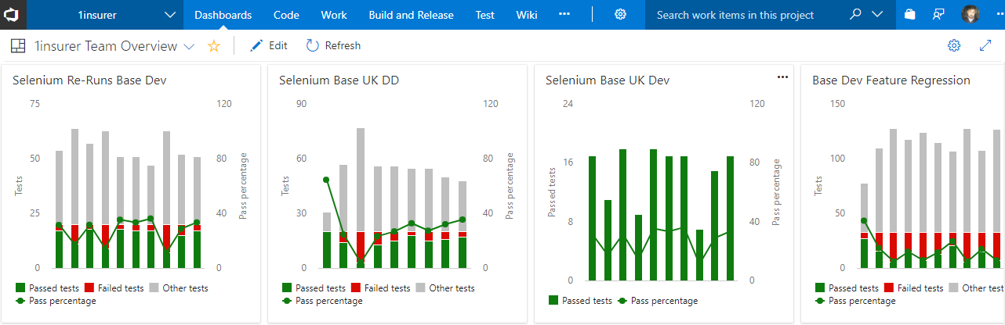
VSTS Dashboard

Slide 15
So, what have we achieved from all this?
Automation, a Safety Net - provided us with essential feedback, kept technical debt to a minimum, and helped drive coding
Improvement in Quality – overall, this is achieved through persistent Team Work while implementing this TestFramework.
Simplicity – all tests are easy to code, easy to maintain, and easy to run
Continuous Testing – enabled by Continuous deployment of artefacts on different servers through VSTS
85% Improvement in Test Execution – a test which takes 40 minutes when run manually now takes only 6 minutes
Earlier Problem Prevention – achieved through continuous testing in the SDLC starting from the early stages of the development
Tests as Living Documentation – achieved through Team’s custom logics and coding principles | Test Expressiveness
Increased Test Coverage |System Health Checks | Regression Packs
100% Flexibility – all tests tensile to new code changes
100% Code Reusability – all tests and methods can be re-used for any possible test scenarios
100% Test Portability – all tests can be ported to or run on any machine / region / environment
0-10% Code Maintainability – all tests, method, and even element are very easy to maintain with no to minimal effort
Data-Driven Testing | Customer Tests – all tests are parameterized and use data from either DB or XML files | No Hard-coded Data
Integrated API Testing – web services testing of different modules in a single framework
Improved System Security – through OWASP ZAP scanning
Timely Reporting – through VSTS Dashboards and E-mails

Slide 16
Demonstration
Run a single Test
Run Multiple Tests Sequentially i.e. one by one
Run Multiple Tests In Parallel i.e. all at once (as per threads defined)

Slide 17
Thank you!
Notes:
Thank you for your attention. Now I am happy to answer any questions you might have.

